Slide 1

Note: The data and information in this document is reflective of a hypothetical situation and client. This document is to be used for KPMG Virtual Internship purposes only.
Sprocket Central Pty Ltd
Data analytics approach
Avi Popat - consultant

Slide 2
Note: The data and information in this document is reflective of a hypothetical situation and client. This document is to be used for KPMG Virtual Internship purposes only.
Agenda
Introduction
Data Exploration
Model Development
Interpretation

Slide 3
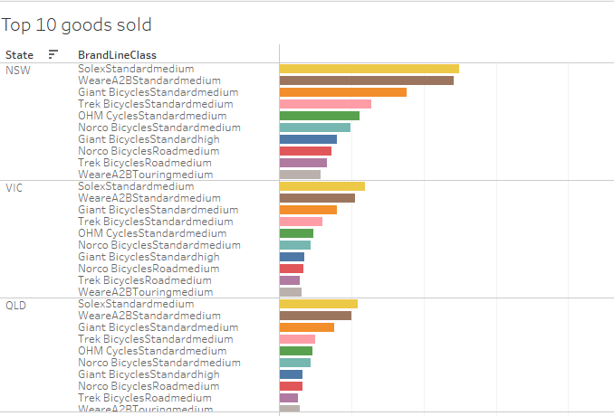
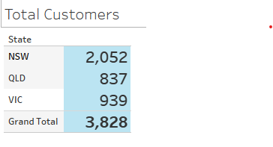
Note: The data and information in this document is reflective of a hypothetical situation and client. This document is to be used for KPMG Virtual Internship purposes only.
Introduction
Sprocket Central Total Customers by State
Total 3828 customers
Little ore than half are in NSW.
Brads popularity is same in all three states.
Top 10 brands Sold by State

Slide 4
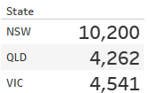
Note: The data and information in this document is reflective of a hypothetical situation and client. This document is to be used for KPMG Virtual Internship purposes only.
Data Exploration
Transactions by state
Total Transactions of bicycles by State.
More transactions in QLD and VIC per customer. QLD and VIC should be targeted.

Slide 5
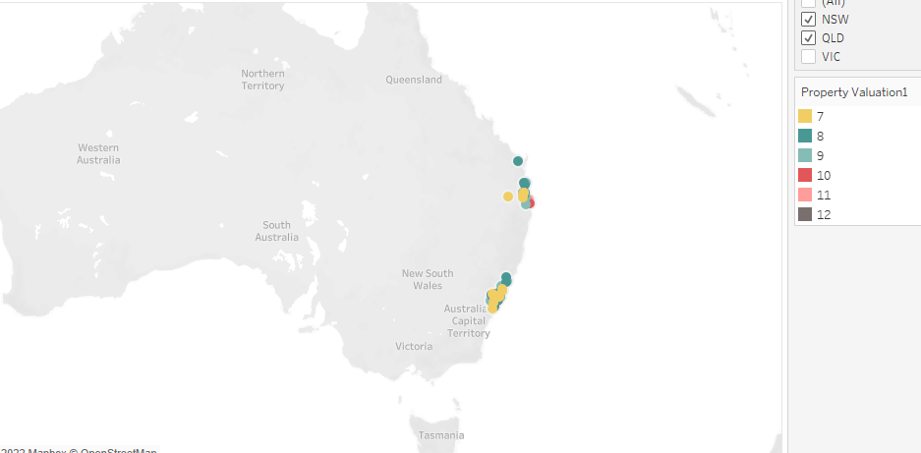
Note: The data and information in this document is reflective of a hypothetical situation and client. This document is to be used for KPMG Virtual Internship purposes only.
Model Development
Target Customers
Geographic distribution of Target Customers based on above analysis (could see better in interactive dashboard).

Slide 6
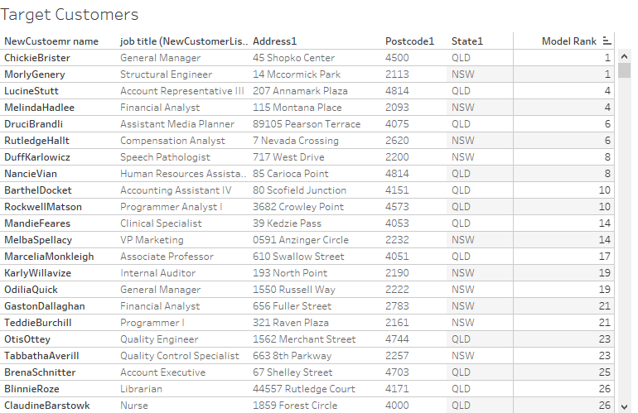
Note: The data and information in this document is reflective of a hypothetical situation and client. This document is to be used for KPMG Virtual Internship purposes only.
Interpretation
List of Target Customers
Based on Analysis VIC and QLD customers will be more willing to buy the bicycles. However, NSW seems to have more customers so should not be overlooked.
Target customers are sorted by wealth and residence status.
Place any supporting images, graphs, data or extra text here.

Slide 7
Note: The data and information in this document is reflective of a hypothetical situation and client. This document is to be used for KPMG Virtual Internship purposes only.
Questions?

